Slide 1
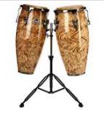
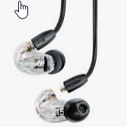
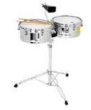
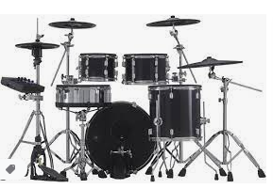
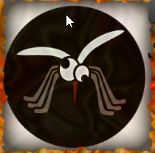
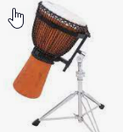
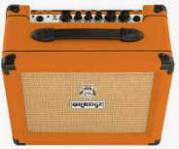
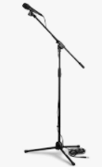
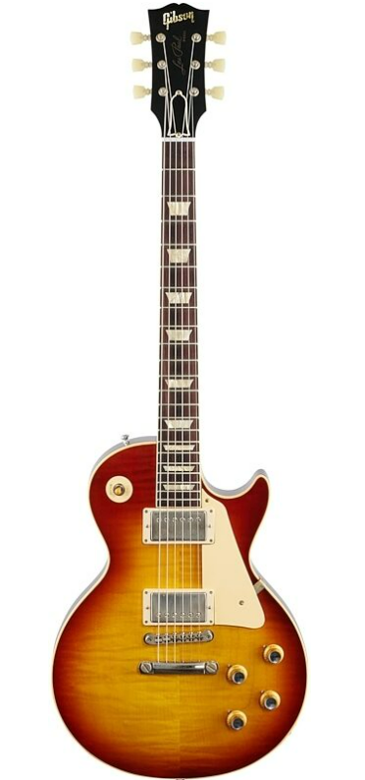
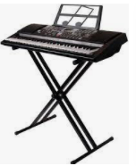
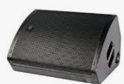
Conga / Djembe
Drums
Saxophone
Conga / Timbale / Bongo
The Mosquitos
IEM’s
2 mics, 1 stand
5 Mics, 1 overhead stand
1 Mic, 1 stand
3 mics, ¼ connector
1 mic
1 mic
DI
Keys / Vocal
Lead Guitar / Vocal
Lead Vocal
Guitar / Vocal
Bass / Vocal
Optional
1 vocal mic , 1 stand , + Stereo Output
1 Vocal mic , 1 stand
1 vocal mic, 1 stand
1 vocal mic, 1 stand
1 vocal mic, 1 Stand

